Slide 1

Web Development & Design Foundations with HTML5
Tenth Edition
Chapter 12
E-Commerce overview
Copyright © 2021, 2019, 2017 Pearson Education, Inc. All Rights Reserved

Slide 2
Learning Outcomes
In this chapter, you will learn how to ...
define e-commerce
identify benefits and risks of e-commerce
describe e-commerce business models
describe e-commerce security and encryption
define Electronic Data Interchange (EDI)
describe trends and projections for e-commerce
describe issues related to e-commerce
describe options for order and payment processing

Slide 3
What is E-Commerce?
The integration of communications, data management, and security technologies to allow individuals and organizations to exchange information related to the sale of goods and services.
Major functions of E-Commerce include:
the buying of goods,
the selling of goods, and
performance of financial transactions on the Internet.

Slide 4
E-Commerce Advantages for Businesses
Reduced Costs
Increased Customer Satisfaction
More Effective Data Management
Potentially Higher Sales

Slide 5
E-Commerce Advantages for Consumers
Convenience
Easier Comparison Shopping
Wider Selection of Goods

Slide 6
E-Commerce Risks for Businesses
Need for a robust, reliable web site
Fraudulent transactions
Customer reluctance to purchase online
Increased competition

Slide 7
E-Commerce Risks for Consumers
Possible Security Issues
Possible Privacy Issues
Purchasing from photos & descriptions
Possible difficulty with returns

Slide 8
E-Commerce Business Models
B2C – Business-to-Consumer
B2B – Business-to-Business
C2C – Consumer-to-Consumer
B2G – Business-to-Government

Slide 9
Electronic Data Interchange (EDI) (1 of 2)
The transfer of data between different companies using networks.
Facilitates the exchange of standard business documents including purchase orders and invoices
First use in the 1960s
Trading Partners
Organizations that exchange EDI transmissions

Slide 10
Electronic Data Interchange (EDI) (2 of 2)
Newer technologies
XML and Web Services are replacing traditional EDI
Provide opportunities to customize secure information exchange over the Internet

Slide 11
E-Commerce U.S. Retail Sales
What do people buy online?
General merchandise ($27.3 billion)
Electronics and appliances ($22.3 billion)
Clothing and accessories ($21.2 billion)
Building material and garden supplies ($7.6 billion)
Furniture and home furnishings ($7 billion)
Sporting goods, hobby, musical instruments, books ($5.8 billion)
Health and personal care ($3.2 billion)
Food and beverage ($1.4 billion)
https://www2.census.gov/programs-surveys/arts/tables/2016/ supecommerce4541.xls

Slide 12
How Many Americans Admit to Being Online “Almost Constantly”?
Table 12.1 Americans online “almost constantly” Data from Pew Research Center Internet Project Survey.
Category | Percentage Online “Almost Constantly”
Adults | 26%
Men | 25%
Women | 27%
Age: 18-29 | 39%
Age: 30-49 | 36%
Age: 50-64 | 17%
Age: Over 65 | 8%
Household Income: Less than $30,000 | 24%
Household Income: $30,000 to $49,999 | 27%
Household Income: $50,000 to $74,999 | 23%
Household Income: $75,000 or higher | 35%
Education: High school graduate | 20%
Education: Some college | 28%
Education: College graduate | 34%
Source: https://www.pewresearch.org/fact-tank/2018/03/14/about-a-quarter-of-americans-report-going-online-almost-constantly/

Slide 13
E-Commerce Issues
Intellectual Property
Security
Fraud
Taxation
International Commerce

Slide 14
E-Commerce Security
Encryption
Ensures privacy within an organization and on the Internet.
The conversion of data into an unreadable form, called a ciphertext.
Decryption
The process of converting the ciphertext back into its original form, called plaintext or cleartext, so it can be understood.
The encryption/decryption process requires an algorithm and a key.

Slide 15
E-Commerce Security Encryption Types
Secure E-Commerce transactions use the encryption technologies below:
Symmetric-key Encryption
Asymmetric-key Encryption
Hash Encryption
SSL (Secure Sockets Layer)
Utilizes these encryption technologies
Provides for secure transmission of data on the Internet.

Slide 16
E-Commerce Security: Symmetric-Key
Symmetric-Key Encryption
Also called single-key encryption
Both encryption and decryption use the same key
Both the sender and receiver must know the key before communicating using encryption.
Advantage: speed

Slide 17
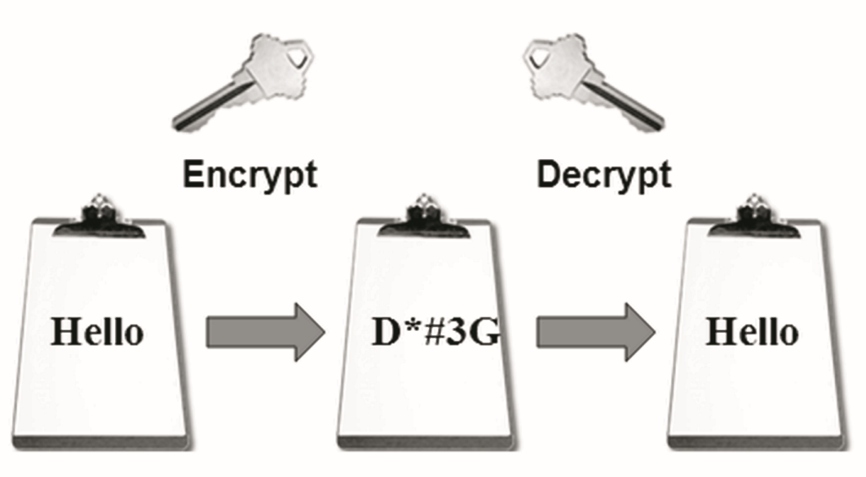
Figure 12.1 Symmetric-key encryption uses a single key

Slide 18
E-Commerce Security: Asymmetric-key
Asymmetric-Key Encryption
Also called public-key encryption
There is no shared secret
Two keys are created at the same time:
Public key
Private key
Asymmetric-key encryption is much slower than symmetric-key encryption.

Slide 19
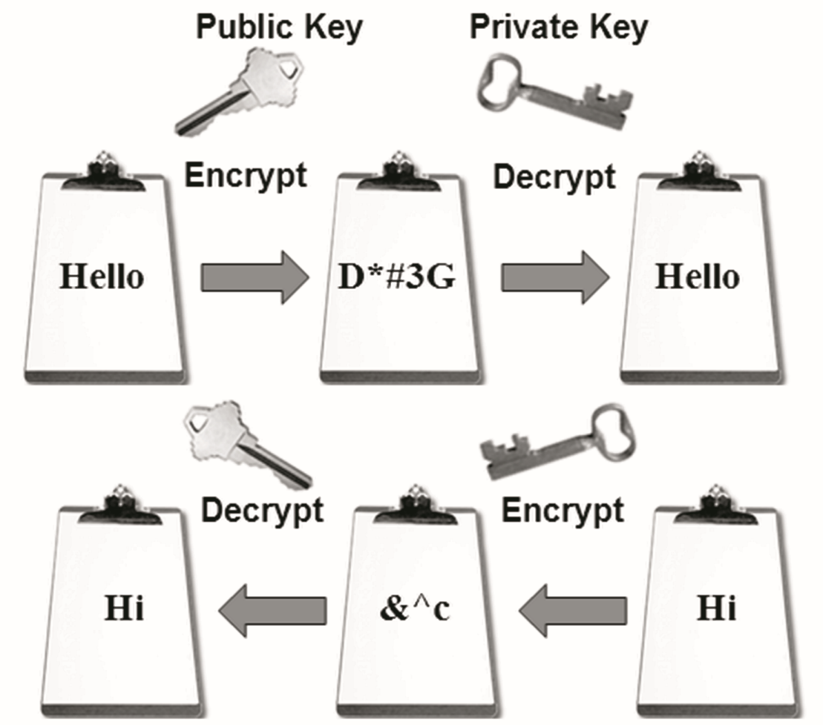
Figure 12.2 Asymmetric-key encryption uses a key pair

Slide 20
E-Commerce Security: Hash
Hash Encryption
A hash algorithm transforms a string of characters into a “digest”
A shorter fixed-length value or key that represents the original string
One-way encryption
Used for information that will not be read or decrypted
Purpose: verify the integrity of information

Slide 21
Secure Sockets Layer (SSL) (1 of 2)
A protocol that allows data to be privately exchanged over public networks
Encrypts data sent between a client (usually a Web browser) and a Web server.
Utilizes both symmetric and asymmetric keys.
“https” protocol
Browsers display a “lock” icon
Replaced by Transport Layer Security (TLS)

Slide 22
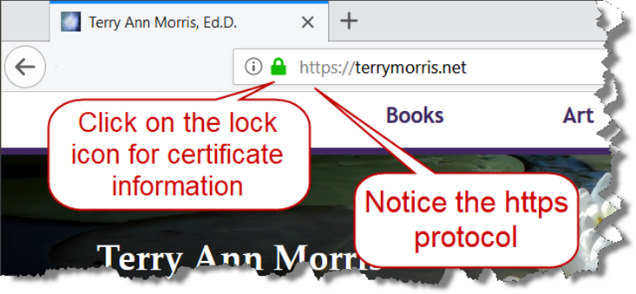
Figure 12.3 The browser indicates that SSL is being used. Screenshots of Mozilla Firefox. Courtesy of Mozilla Foundation.

Slide 23
Secure Sockets Layer (SSL) (2 of 2)
SSL provides secure communication between a client and server by using:
Server and (optionally) client digital certificates for authentication
Symmetric-key cryptography using a "session key" for bulk encryption
Public-key cryptography for transfer of the session key
Message Digests (hash encryption) to verify the integrity of the transmission

Slide 24
SSL & Digital Certificate
Digital Certificate
A form of an asymmetric key
Also contains information about the certificate, the holder of the certificate, and the issuer of the certificate.
Used by SSL to authenticate the identity of the web server

Slide 25
Digital Certificate
The contents of a digital certificate include:
The public key
Effective date of the certificate
Expiration date of the certificate
Details about the Certificate Authority – the issuer of the certificate
Details about the certificate holder
A digest of the certificate content

Slide 26
Certificate Authority
A trusted third-party organization or company that issued digital certificates.
Well-known Certificate Authorities:
Verisign
https://www.verisign.com
Thawte
https://www.thawte.com
Entrust https://www.entrust.com

Slide 27
Checkpoint (1 of 3)
Describe three advantages of e-commerce for an entrepreneur just starting a business.
Describe three risks that businesses face when engaging in e-commerce.
Define SSL. Describe how an online shopper can tell that an e-commerce site is using SSL.

Slide 28
Order & Payment Processing
E-Commerce Payment Methods:
Credit Card
Stored-value Card
Smart Card
Digital Wallet
Digital Cash

Slide 29
E-Commerce Storefront Solutions
Instant Online Storefront
Shopify, BigCommerce
Shopping Cart Software
Agoracart, osCommerce, ZenCart
Easy Entry to E-Commerce
PayPal Shopping Cart & Payment Verification
E-Commerce Platform
Microsoft Azure Commerce
Adobe Commerce Cloud

Slide 30
Checkpoint (2 of 3)
List three payment methods commonly used on the Web.
Have you purchased online? If so, think of the last item that you purchased.
Why did you purchase it online instead of at a store?
Did you check to see if the transaction was secure? Why or why not?
How will your shopping habits be different in the future?

Slide 31
Checkpoint (3 of 3)
Describe three types of e-commerce solutions available. Which provides the easiest entry to e-commerce? Explain.

Slide 32
Summary
This chapter introduced you to basic e-commerce concepts and implementations.
Consider taking an E-Commerce course in the future to continue your study of this dynamic and growing area of web development.

